Slide 1
Example Addressing Mode
Ref: Mano:- Computer System Architecture

Slide 2
Numerical Example :-Word addressable Accumulator based Computer with Two-word instruction at address 200 and 201
First word of instruction contains op code :"load to AC”instruction,
and mode
Second word of instruction contains operand field equal to 500
PC has the value 200 for fetching this instruction
Content of processor register R 1 is 400,
Content of an index register XR is 100
AC receives the operand after the instruction is executed
Following slide figure lists other addresses of memory and their content

Slide 3
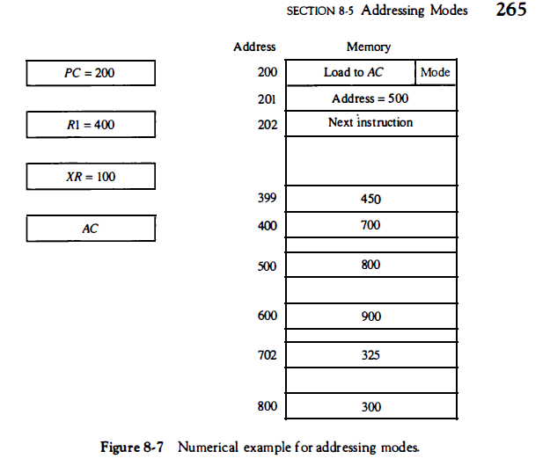

Slide 4
Numerical Example
Mode field of the instruction can specify any one of a number of modes.
For each mode we calculate the effective address and the operand that must be loaded into AC .
1. In direct address mode
  the effective address = address part of the instruction =500
  operand to be loaded into AC is 800
2. In immediate mode the second word of the instruction is taken as the operand rather than an address
  so 500 is loaded into AC (effective address in this case is 201 )
3.In indirect mode
  the effective address is stored in memory at address 500. Therefore, the effective address is 800
  the operand is 300.

Slide 5
Numerical Example(Ref: Mano –Computer System Architecture)
4. In the relative mode
  effective address is 500 + 202 = 702
  operand is 325. (Note that the value in PC after the fetch phase and during the execute phase is 202.)
5.In the index mode
  effective address is XR + 500 = 100 + 500 = 600
  operand is 900.
6.In the register mode the
  operand is in R 1 and 400 is loaded into AC . (There is no effective address in this case. )

Slide 6
Numerical Example(Ref: Mano –Computer System Architecture)
7. In the register indirect mode
  effective address is 400, equal to the content of R 1
  operand loaded into AC is 700.
8. The autoincrement mode is the same as the register indirect mode
  except that R 1 is incremented to 401 after the execution of the instruction.
The autodecrement mode
  decrements R1 to 399 prior to the execution of the instruction.
  operand loaded into AC is now 450
Following Table 8-4 lists the values of the effective address and the operand loaded into AC for the nine addressing modes.

Slide 7
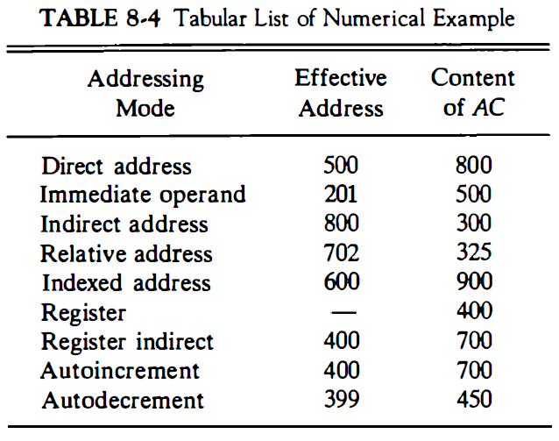

Slide 8
Example Addressing Mode
Ref: Hamacher:- Computer Organization

Slide 9
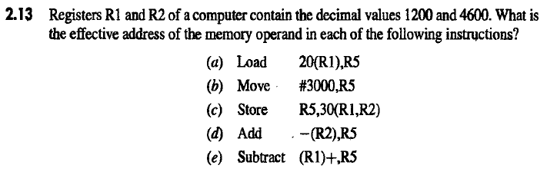

Slide 10
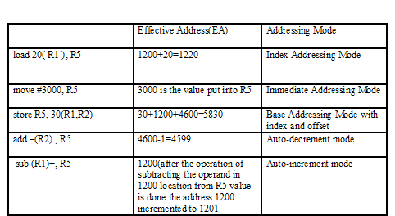
Assuming Word Addressable Processor
R1=1200, R2=4600
R5
1199
33
3000
3060
1860
Memory
1220 …. | 33
4599 | 60
. .
5830 | 3000

